Slide 1

Hadeel Elmadhoon, Laith Darwish, and Nadeen Elshawish

Slide 2
The Problem
Difficulty navigating
Lack of independence
Mental health issues
Decreased self-confidence

Slide 3
Current Solutions

Slide 4
Navigating
Mental health
Confidence

Slide 5
Navigating
Mental health
Confidence
Navigating

Slide 6
Navigating
Mental health
Confidence
Independence
Mental health
Confidence
Navigating

Slide 7
Our Solution
Turn a human into a Tesla
Fully independent to use
Small and light
Discrete

Slide 8
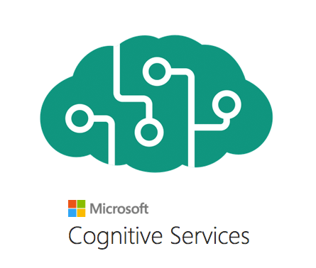
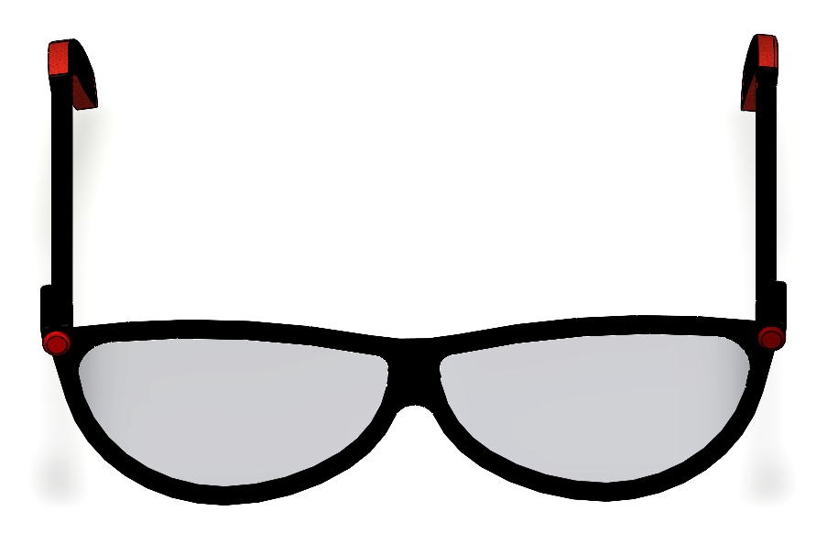
The Technology
Coded in Python
Captured with Raspberry Pi and Touchscreen
Based on Azure Cognitive Services:
Computer Vision
Translating Text
Text to Speech

Slide 9

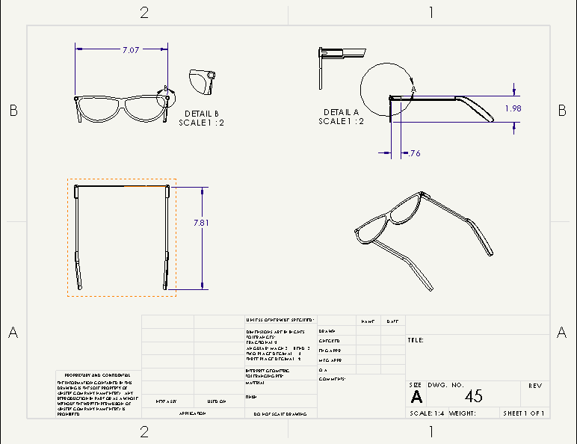

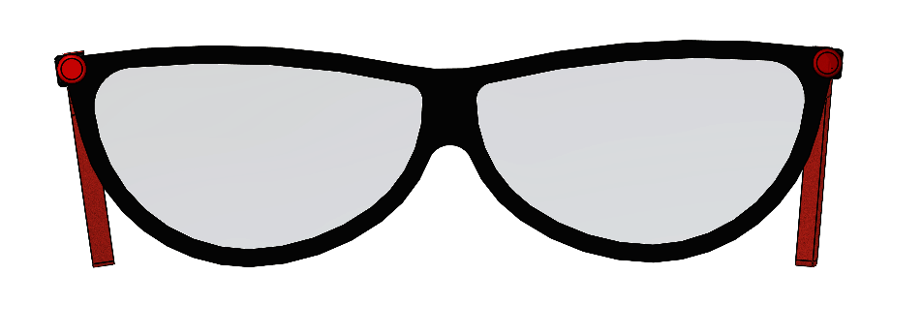
The Design

Slide 10
For Everyone
Supports 45 languages
Can be attached to any pair of glasses

Slide 11
Hadeel Elmadhoon, Laith Darwish, and Nadeen Elshawish

